Slide 1
TWITTER AIRLINE SENTIMENTS USING NATURAL LANGUAGE PROCESSING
CS 6120
Professor Uzair Ahmed
Group 5
Uma Mahesh Avalapati
Siddhant Dube

Slide 2
INTRODUCTION
Identifying the general sentiment of a given document is the goal of sentiment analysis. For our project, these documents can be considered as tweets posted on Twitter.
All the tweets related to airlines were categorized into "positive," "negative," and "neutral" emotions.

Slide 3
METHODOLOGY
The dataset was observed and the null counts for each feature was obtained.
The features eliminated after viewing their null count percentages were
airline_sentiment_gold
negativereason_gold
tweet_coord

Slide 4
TEXT CLEANING
Each tweet was cleaned to improve the performances when the data would be fitted into the models. A few techniques were used to clean the text, which are as follows:
Punctuation Removal: All the punctuations used in the text were removed
Lower Casing: All the words were converted into a lower case
Lemmatization: Grouping together different inflected forms of a word

Slide 5
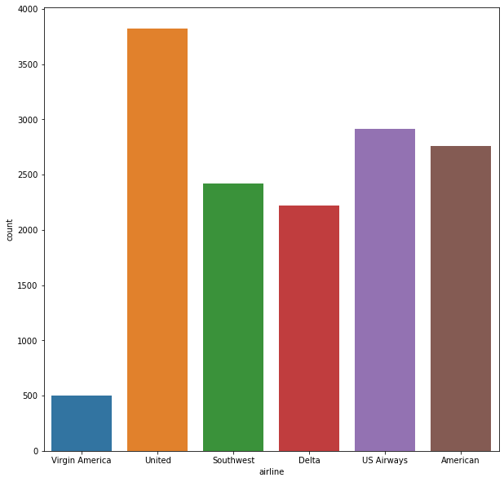
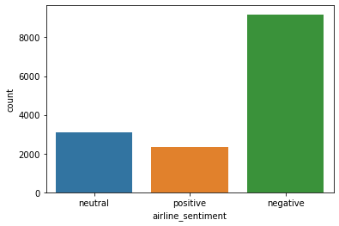
VISUALIZATION
TWEET SENTIMENT DISTRIBUTION
NUMBER OF TWEETS FOR AN AIRLINE

Slide 6
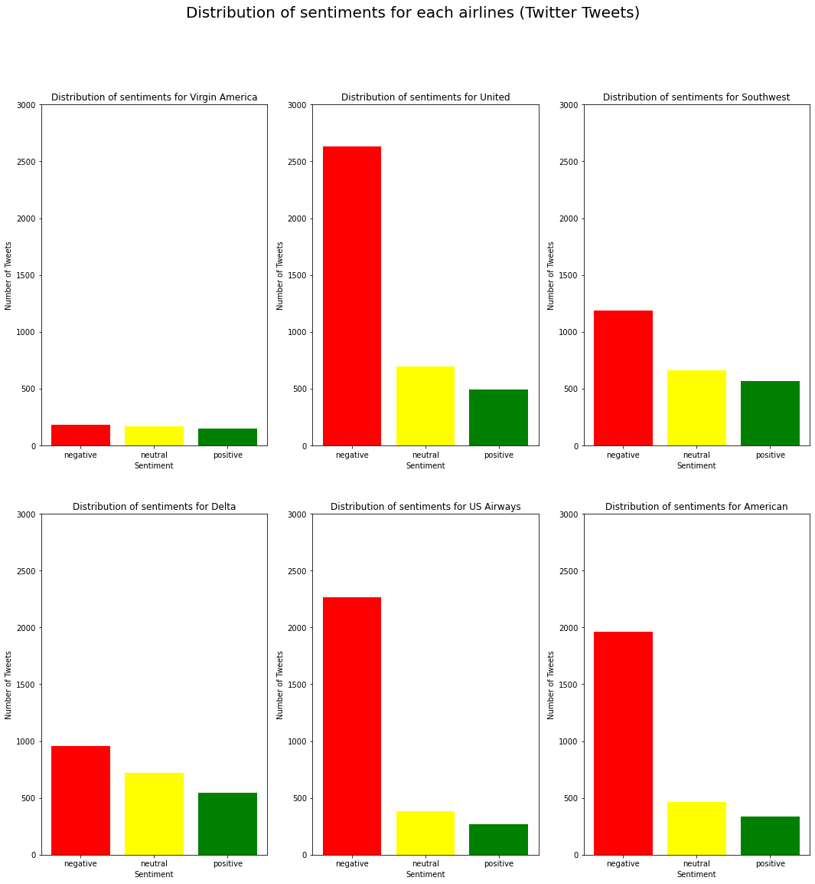
DISTRIBUTION OF SENTIMENTS FOR EACH AIRLINES

Slide 7
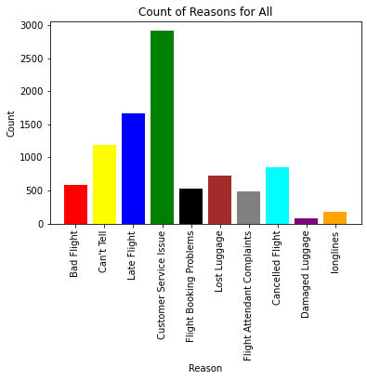
REASONS FOR A NEGATIVE SENTIMENT

Slide 8
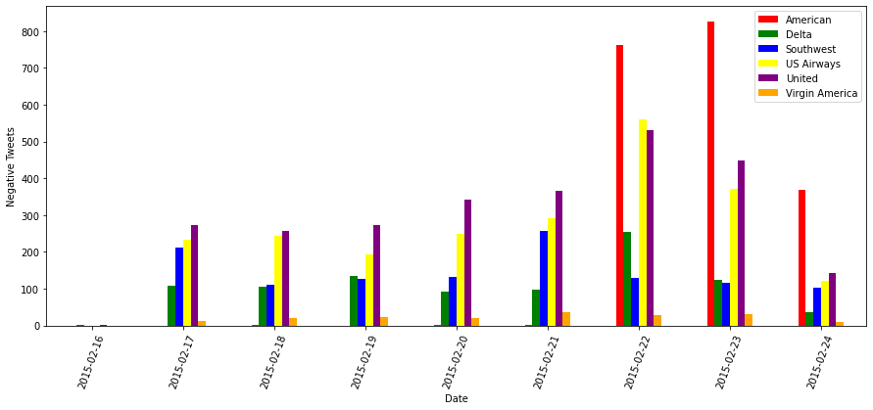
NEGATIVE REVIEWS OVER TIME

Slide 9
WORD EMBEDDING TECHNIQUES
Two frequency based word embedding techniques were implemented in this study, the CountVectorizer and the Term Frequency-Inverse Document Frequency (TF-IDF) Vectorizer.
CountVectorizer: The count vectorizer converts text into a matrix that consists of the word counts.
TF-IDF Vectorizer: The TF-IDF vectorizer computes a score for each word inside a document which corresponds to its importance in the document.

Slide 10
ENCODING TECHNIQUES
We made use of two encoders for this study, the LabelEncoder and the One Hot Encoder to convert the outcome feature into a numerical representation.
Label Encoder: It works by assigning a number to each of the different categories present in the column.
One Hot Encoder: The One Hot Encoder works by creating new features equal to the amount of distinct categories in the outcome column of the dataset.
Results obtained from the Label Encoder were omitted

Slide 11
MODEL IMPLEMENTATION
A total of 9 different models were used across the dataset for this study. Mainly to compare how each of those would perform in terms of the accuracy.
The following were the models used:
Sequential Neural Network
Support Vector Machine
Logistic Regression
K Neighbours Classifiers
SVC
Decision Trees
Random Forest
Ada Boost Classifier
Gaussian Naïve Bayes

Slide 12
RESULTS
Sequential Neural Network
Using Count Vectorizer: Accuracy 96.12%
Using TF-IDF Vectorizer: Accuracy 91.24%
Support Vector Machine
Testing AUC: 0.9562
Testing Accuracy: 90.81%
Logistic Regression
Testing Accuracy: 85.32%
K Neighbors Classifier
Testing Accuracy: 86.46%
SVC
Testing Accuracy: 85.40%
Decision Trees
Testing Accuracy: 85.24%
Random Forest
Testing Accuracy: 92.72%
Ada Boost Classifier
Testing Accuracy: 91.05%
Gaussian Naïve Bayes
Testing Accuracy: 67.29%

Slide 13
DISCUSSION
Although the accuracy obtained from this study was high enough to conclude that the tweets were being correctly classified into one of the 3 categories, further improvements can always be made. One way this could be done is that the number of tweets taken for this study was limited to the date of February of 2015. If more tweets could be considered, the accuracy of categorizing tweets into a class of sentiment would have been much higher.
Apart from altering the data, making use of more complex vectorizers to transform the data into a numerical format would aid in better performing accuracies.

Slide 14
CONCLUSION
Throughout this study, we altered our dataset a few times to tune it in order to fit properly into a model. It was found that the neutral sentiment did not add much value into the study and was hence removed. From all the 9 models which were used to train the data, the Sequential Neural Network model has obtained the highest accuracy of 96.12% using the CountVectorizer technique to transform the data.
Another main decision made during this study was to exclude the results obtained from Label Encoding. This was to support the fitting of the data into the models as a Label Encoder did not contain any number of rows after the transformation.

Slide 15
THANK YOU!

